Slide 1
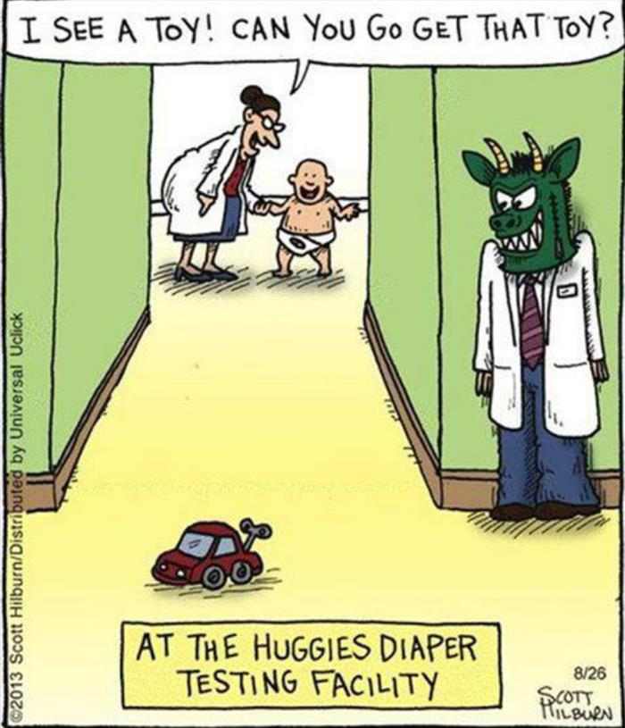
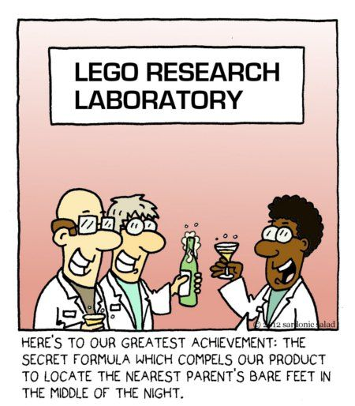
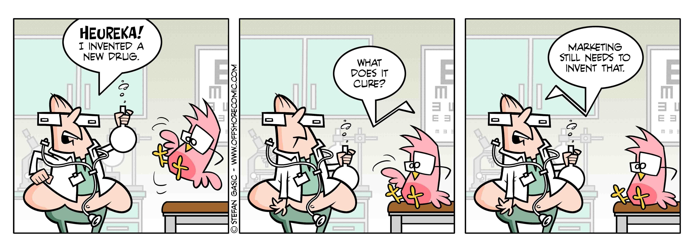
Topic 7: Innovation
Industrial Organisation / Matěj Bajgar

Slide 2
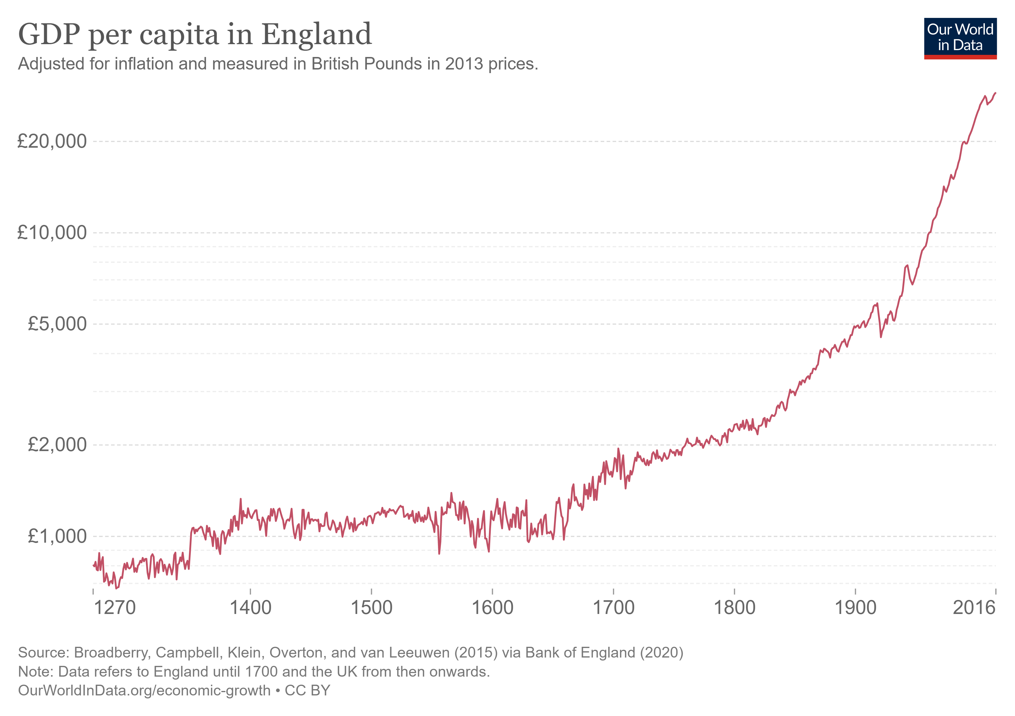
Why should I care?

Slide 3
Innovation matters
Nordhaus (1996): Do Real-Output and Real-Wage Measures Capture Reality? The History of Lighting Suggests Not

Slide 4

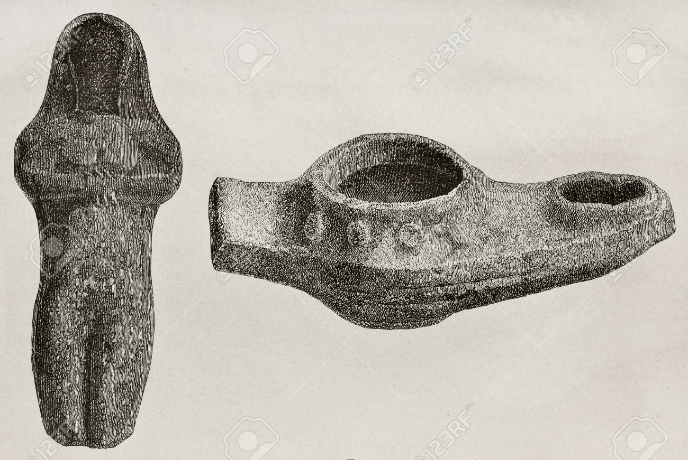
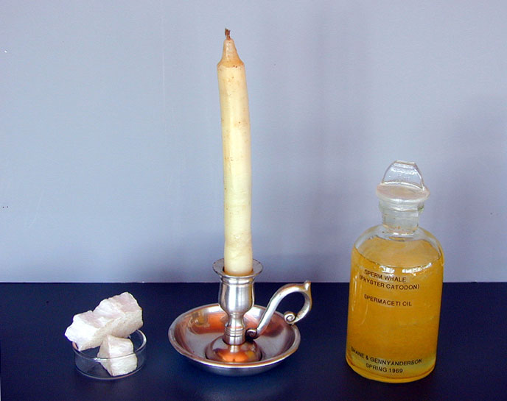



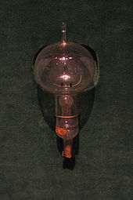


Slide 5
Topic outline
Market structure and incentives to innovate
Threat of entry and incentives to innovate
Spillovers from R&D
Public policy towards R&D
Intellectual property protection

Slide 6
Innovation dictionnary
Research & experimental development (R&D)
= “creative and systematic work undertaken in order to increase the stock of knowledge and to devise new applications of available knowledge” (OECD Frascati Manual)
it has to be novel ➔ does not include imitation
Innovation
= new or improved products, services or processes (may be just new to the firm)
By content
Product innovation = new goods or services
Process innovation = reduction in costs or improvement in quality
By size
Radical/drastic innovation makes the innovating firm a monopoly
Incremental/non-drastic innovation – the innovator still faces competition

Slide 7
Topic outline
Market structure and incentives to innovate
Threat of entry and incentives to innovate
Spillovers from R&D
Public policy towards R&D
Intellectual property protection

Slide 8
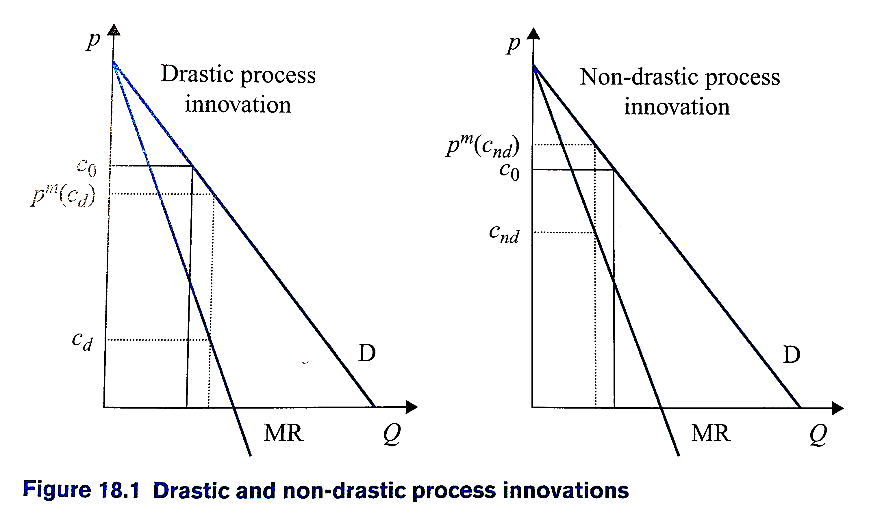
Market structure and incentives to innovate
Consider a Bertrand market with homogenous product and homogenous MC=c₀
One firm innovates, reducing MC to c_{d} or c_{nd}

Slide 9
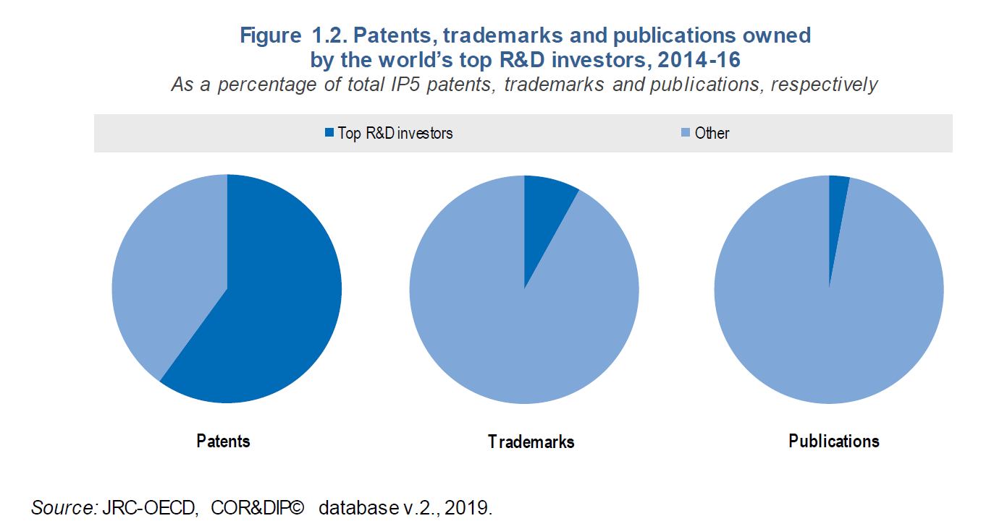
Innovation is highly concentrated
Top 2000 companies

Slide 10
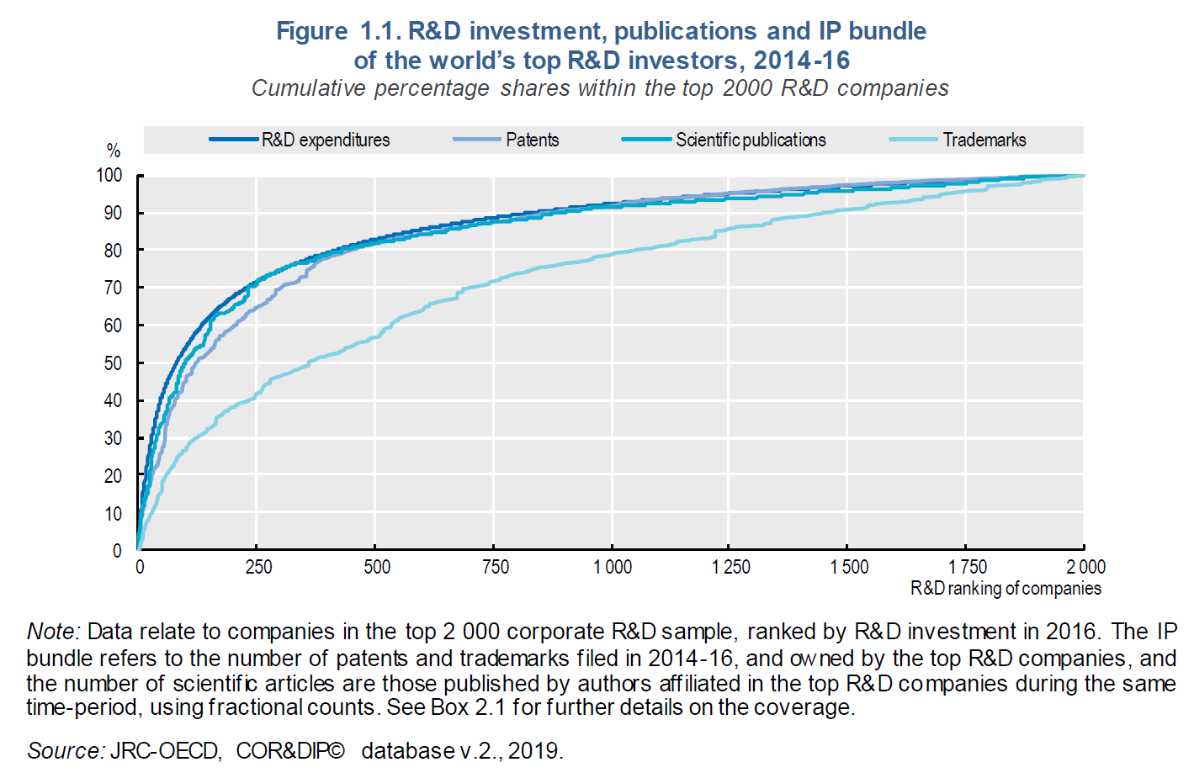
Innovation is highly concentrated

Slide 11
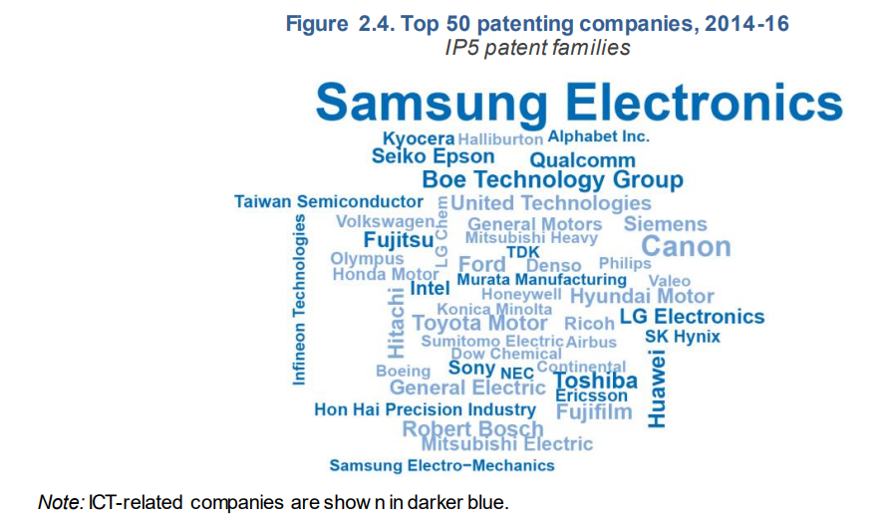
Innovation is highly concentrated

Slide 12
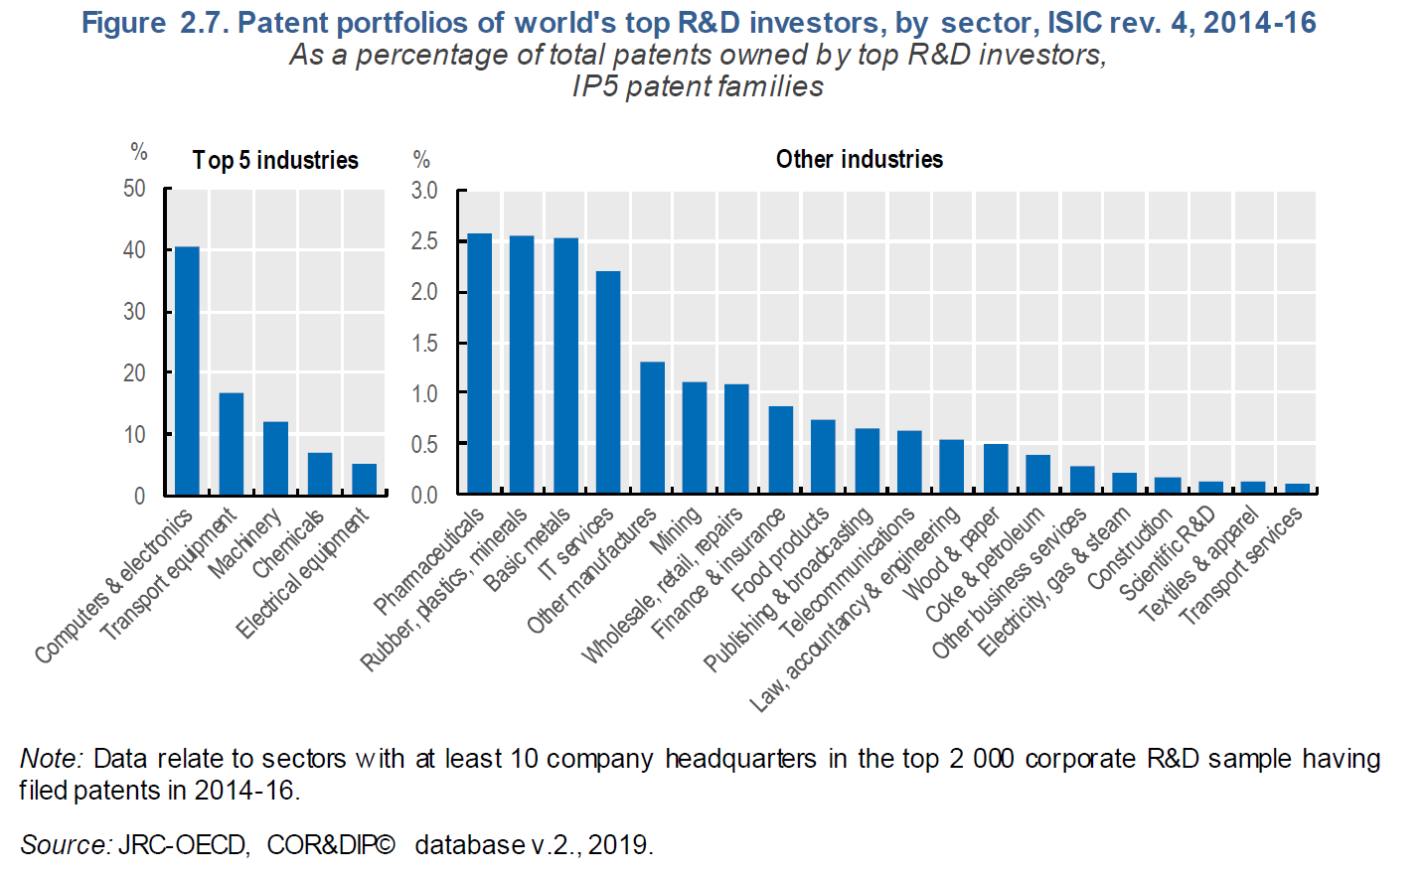
Innovation is highly concentrated

Slide 13

Market structure and incentives to innovate
“As soon as we go into details and inquire into the individual items in which progress was most conspicuous, the trail leads not to the doors of those firms that work under conditions of comparatively free competition but precisely to the door of the large concerns ... and a shocking suspicion dawns upon us that big business may have had more to do with creating that standard of life than with keeping it down.”
Joseph Schumpeter (1942)

Slide 14
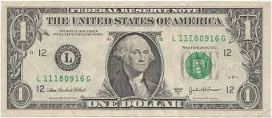


Market structure and incentives to innovate
Ability to innovate
Why might large companies be best able to innovate?
Access to funding
With perfect capital markets, projects with E(return) > 0 should be funded
R&D risky and hard to use as a collateral ➔ it may be difficult to get a loan
Venture capital requires that you reveal your idea
➔ Funding matters!
Ability to leverage scale economies
Ability to bring innovations to the market
But...
What about all the innovative start-ups?
Large companies too bureaucratic and conservative?
Incremental vs. radical innovation?

Slide 15
Market structure and incentives to innovate
Incentives to innovate
There might be a trade-off between static and dynamic efficiency
Perfect competition guarantees the former
Monopoly (i.e., ”big business”) is good for the latter.
Is that true? How to create incentives to innovate while preserving static competition?

Slide 16
Market structure and incentives to innovate
Let‘s focus on incremental process innovation
Set up:
A start-up has developed an innovation
...but is not able to bring it to the market
The innovation reduces marginal cost from c₀ to c₁ (assume non-drastic)
Market demand P(Q) = 1 - Q
What is the value of the innovation (acquisition or licensing) to ...?
Social planner
Competitive firm
Monopolist

Slide 17
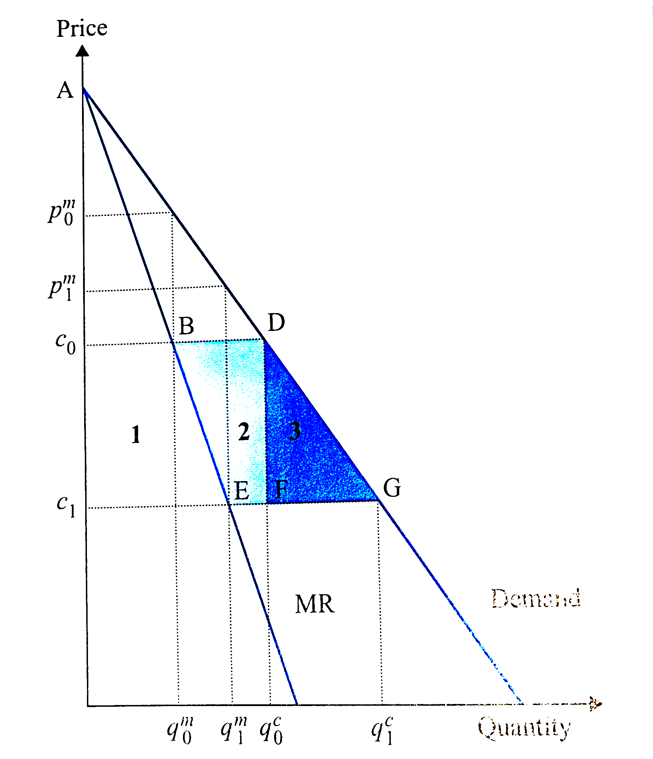
Market structure and incentives to innovate
Social planner (controls production and price)
Reduction of MC from c₀ to c₁ increases social surplus by area 1 + 2 + 3

Slide 18
Market structure and incentives to innovate
Firm in a competitive market (Bertrand with homogenous products and costs)
Without the innovation, P = c₀ and all firms earn π=0
Reduction of MC from c₀ to c₁ increases the firm‘s profit by area 1 + 2
➔ Incentives to innovate socially suboptimal

Slide 19
Market structure and incentives to innovate
A monopoly
Without the innovation
P = p₀^{m}
Profit can be measured as (p₀^{m} -c₀)q₀^{m}...
...but also as the area between MR and MC, i.e. the triangle Ac₀B
Reduction of MC from c₀ to c₁ increases the firm‘s profit by area 1
➔ Incentives to innovate smaller than for a competitive firm

Slide 20
Market structure and incentives to innovate
Incentives^{social planner} > Incentives^{competitive firm} > Incentives^{monopoly}
Intuition for the 1st inequality: competitive firm and monopolist do not care about consumer surplus, so they value the innovation insofar it increases their profits
Intuition for the 2nd inequality (the replacement effect): for firm in a competitive environment the innovation creates a new profit opportunity, for a monopolist it only replaces existing profits
➔ Large firms with market power better able to innovate but less incentives to do so
NOTE: We assumed that innovating firm becomes a monopolist, if innovation can be imitated, incentives to innovate would disappear (more on this later)

Slide 21
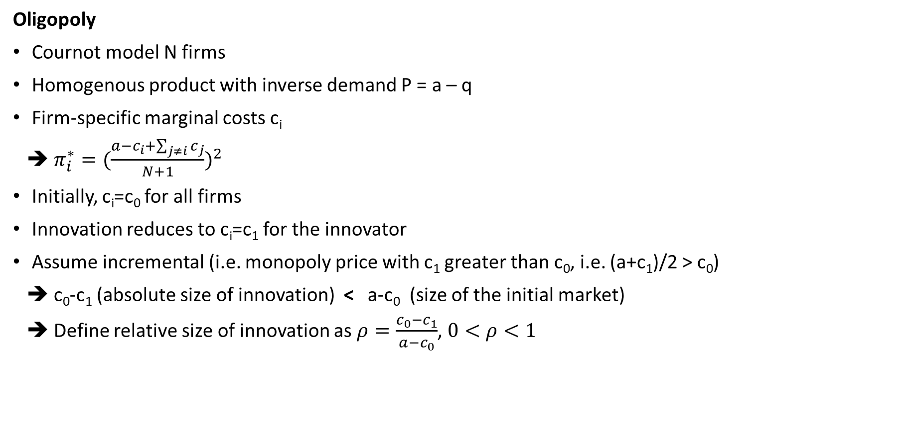
Market structure and incentives to innovate
Oligopoly
Cournot model N firms
Homogenous product with inverse demand P = a – q
Firm-specific marginal costs c_{i}
➔ $π_{i}^{∗}={(\frac{a−c_{i}+\sum_{j≠i}{c_{j}}}{N+1})}^{2}$
Initially, c_{i}=c₀ for all firms
Innovation reduces to c_{i}=c₁ for the innovator
Assume incremental (i.e. monopoly price with c₁ greater than c₀, i.e. (a+c₁)/2 > c₀)
➔ c₀-c₁ (absolute size of innovation) < a-c₀ (size of the initial market)
➔ Define relative size of innovation as $ρ=\frac{c_{0}{−c}_{1}}{a−c_{0}}$, $0<ρ<1$

Slide 22
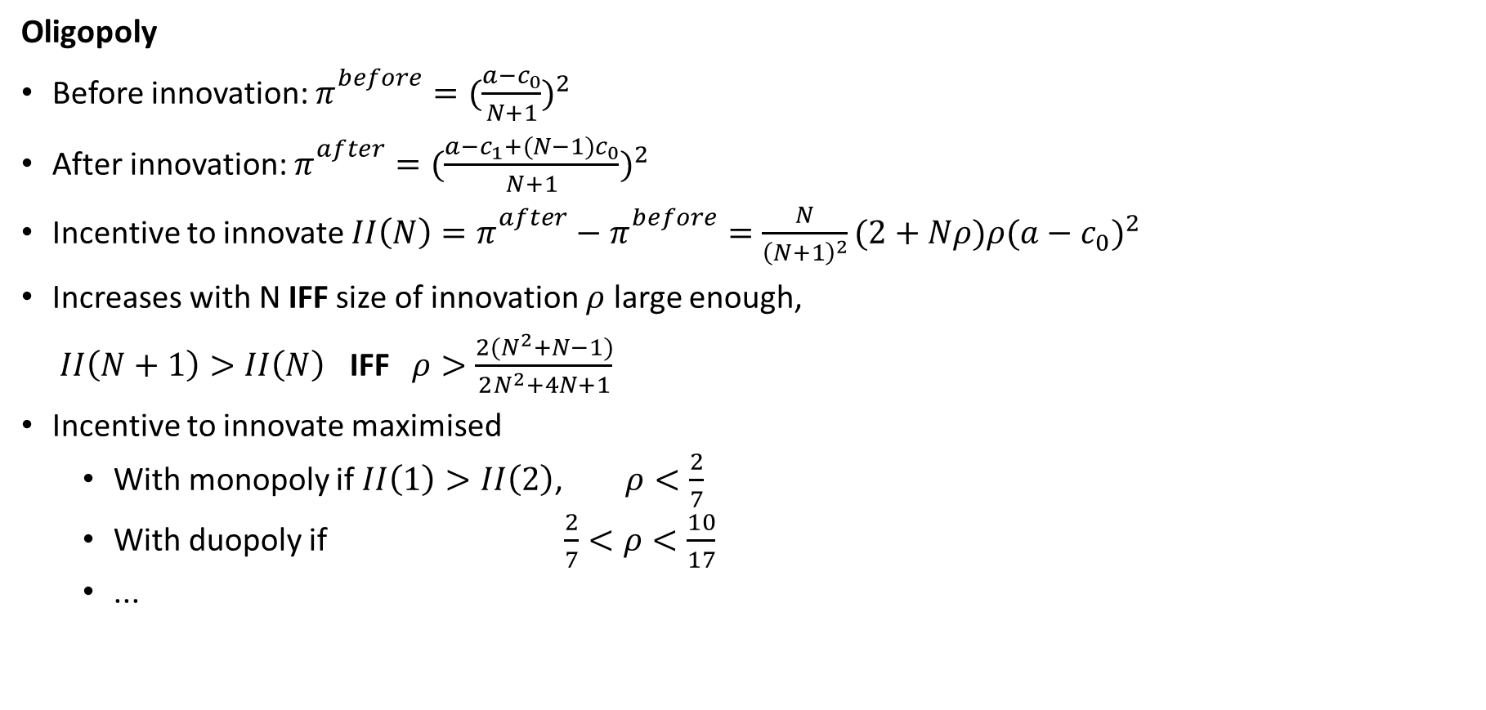
Market structure and incentives to innovate
Oligopoly
Before innovation: $π_{}^{before}={(\frac{a−c_{0}}{N+1})}^{2}$
After innovation: $π_{}^{after}={(\frac{a−c_{1}+(N−1)c_{0}}{N+1})}^{2}$
Incentive to innovate $II\left(N\right)={π_{}^{after}−π}_{}^{before}=\frac{N}{{\left(N+1\right)}^{2}}(2+Nρ)ρ{(a−c_{0})}^{2}$
Increases with N IFF size of innovation $ρ$ large enough,
$II\left(N+1\right)>II\left(N\right)$ IFF $ρ>\frac{2(N^{2}+N−1)}{2N^{2}+4N+1}$
Incentive to innovate maximised
With monopoly if $II\left(1\right)>II\left(2\right)$, $ρ<\frac{2}{7}$
With duopoly if $\frac{2}{7}<ρ<\frac{10}{17}$
...

Slide 23
Market structure and incentives to innovate
Oligopoly
Unless innovation relatively small, incentive to innovate largest with oligopoly
„Optimal“ number of firms grows with the size of innovation
INTUITION = two conflicting effect
A larger number of firms reduces profits for innovating and non-innnovating firms
The more firms overall, the more firms over which an innovating firm gets an advantage
➔ Relationship between competition and innovation has an inverse U shape

Slide 24
Topic outline
Market structure and incentives to innovate
Threat of entry and incentives to innovate
Spillovers from R&D
Public policy towards R&D
Intellectual property protection

Slide 25
Threat of entry and incentives to innovate
A simple model
One incumbent and one potential entrant
If nobody purchases the innovation: the monopolist gets π^{m}
If the incumbent purchases, he gets π^{m} (we assume a strong replacement effect)
If the entrant purchases, entry takes place, and both firms get π^{d}
The incumbent and the entrant simultaneously submit bids for the innovation.
Who will bid higher?
Incumbent: up to π^{m} – π^{d}
Entrant: up to π^{d}
The incumbent will innovate iff π^{m} > 2π^{d}
π^{m} > 2π^{d} always holds with homogenous products and linear costs (π^{m} > 2π^{d} might not hold if products very heterogenous and the entrant brings a lot of new customers
SUMMARY: The incumbent has stronger incentives to innovate in order to protect its monopoly power ➔ the efficiency effect

Slide 26

Threat of entry and incentives to innovate
Application 1: Blocking patents
Firms amass a huge number of patents, many of which they don‘t use
One explanation is that this is to make entry difficult

Slide 27
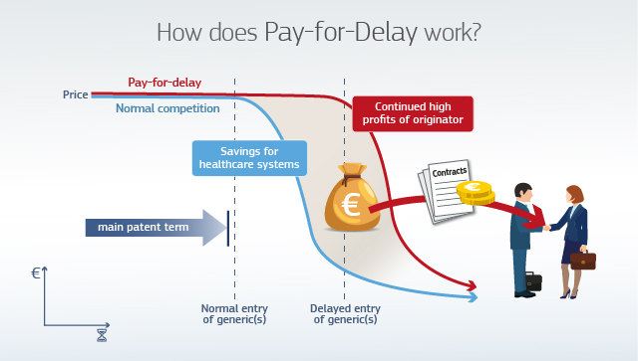
Threat of entry and incentives to innovate
Application 2: Pay-for-delay agreements
Common in pharmaceuticals
Drug makers pay generics manufacturer to delay market entry
The efficiency effect explains why this is rational for both parties

Slide 28
Exercise 1: Incentives to innovate (Belleflamme & Peitz 18.1)
An innovation reduces the marginal costs of making trucks from 70 to 60
Inverse demand for trucks is p = 100 – q
Confirm innovation non-drastic (unless it reduces MC below 40)
How much would a monopoly be willing to pay for the innovation?
How much would a firm in a Bertrand oligopoly be willing to pay?
How much would a Cournot duopolist be willing to pay?
What about a monopolist with a thread of entry (→ Cournot duopoly)?
Compare incentives to innovate in the different markets?

Slide 29
Topic outline
Market structure and incentives to innovate
Threat of entry and incentives to innovate
Spillovers from R&D
Public policy towards R&D
Intellectual property protection

Slide 30
R&D spillovers
So far R&D spending has only benefited the firm that does it
But R&D may have spillovers due to knowledge externalities
Discovery by one firm may lead to another discovery by someone else
Knowledge may leak from firm to firm
Evidence suggests spillovers important
What do spillovers mean for
Incentives to innovate?
Public policy?

Slide 31
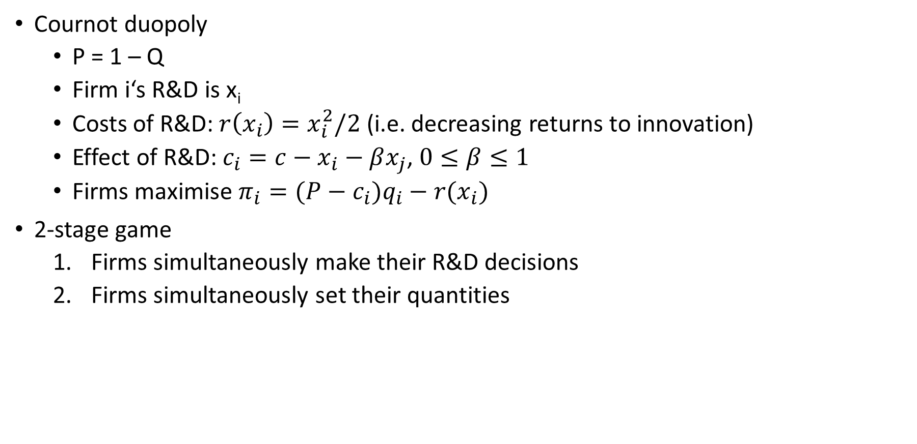
R&D spillovers
Cournot duopoly
P = 1 – Q
Firm i‘s R&D is x_{i}
Costs of R&D: $r\left(x_{i}\right)=x_{i}^{2}/2$ (i.e. decreasing returns to innovation)
Effect of R&D: $c_{i}=c−x_{i}−βx_{j}$, $0≤β≤1$
Firms maximise $π_{i}=(P−c_{i})q_{i}−r{(x}_{i})$
2-stage game
Firms simultaneously make their R&D decisions
Firms simultaneously set their quantities

Slide 32
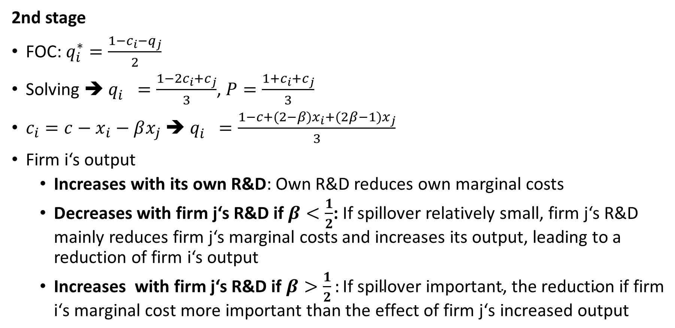
R&D spillovers
2nd stage
FOC: $q_{i}^{∗}=\frac{1−c_{i}−q_{j}}{2}$
Solving ➔ $q_{i}^{}=\frac{1−2c_{i}+c_{j}}{3}$, $P=\frac{1+c_{i}+c_{j}}{3}$
$c_{i}=c−x_{i}−βx_{j}$ ➔ $q_{i}^{}=\frac{1−c+(2−β)x_{i}+(2β−1)x_{j}}{3}$
Firm i‘s output
Increases with its own R&D: Own R&D reduces own marginal costs
Decreases with firm j‘s R&D if $β<\frac{1}{2}$: If spillover relatively small, firm j‘s R&D mainly reduces firm j‘s marginal costs and increases its output, leading to a reduction of firm i‘s output
Increases with firm j‘s R&D if $β>\frac{1}{2}:\text{If} \text{spillover} \text{important}\text{, }\text{the} \text{reduction} \text{if} \text{firm} \text{i}\text{‘}\text{s} \text{marginal} \text{cost} \text{more} \text{important} \text{than} \text{the} \text{effect} \text{of} \text{firm} \text{j}\text{‘}\text{s} \text{increased} \text{output}$

Slide 33
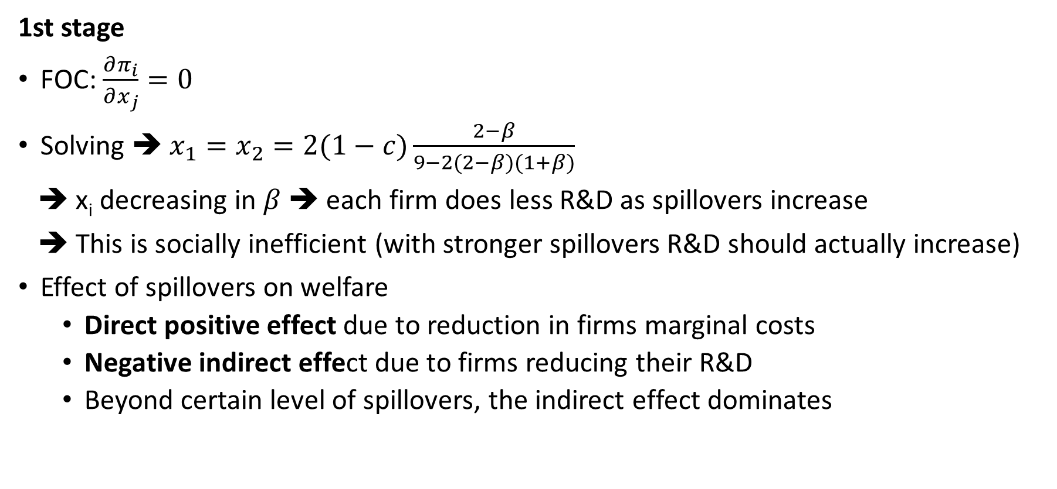
R&D spillovers
1st stage
FOC: $\frac{∂π_{i}}{∂x_{j}}=0$
Solving ➔ $x_{1}=x_{2}=2(1−c)\frac{2−β}{9−2(2−β)(1+β)}$
➔ x_{i} decreasing in $β$ ➔ each firm does less R&D as spillovers increase
➔ This is socially inefficient (with stronger spillovers R&D should actually increase)
Effect of spillovers on welfare
Direct positive effect due to reduction in firms marginal costs
Negative indirect effect due to firms reducing their R&D
Beyond certain level of spillovers, the indirect effect dominates

Slide 34
R&D spillovers
R&D spillovers reduce incentives to innovate
Would it help to allow firms to cooperate (i.e. collude) in R&D expenditures (1st stage) while still competing in quantities (2nd stage)?
2nd stage the same as before
But externalities internalised in the 1st stage

Slide 35
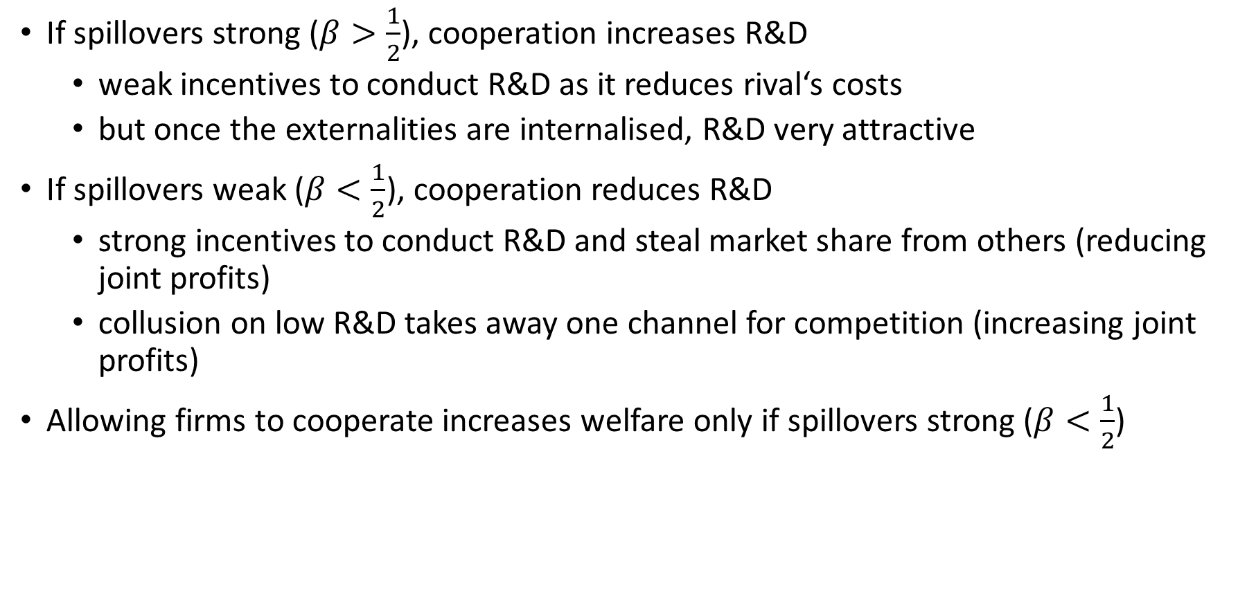
R&D spillovers
If spillovers strong ($β>\frac{1}{2}$), cooperation increases R&D
weak incentives to conduct R&D as it reduces rival‘s costs
but once the externalities are internalised, R&D very attractive
If spillovers weak ($β<\frac{1}{2}$), cooperation reduces R&D
strong incentives to conduct R&D and steal market share from others (reducing joint profits)
collusion on low R&D takes away one channel for competition (increasing joint profits)
Allowing firms to cooperate increases welfare only if spillovers strong ($β<\frac{1}{2}$)

Slide 36
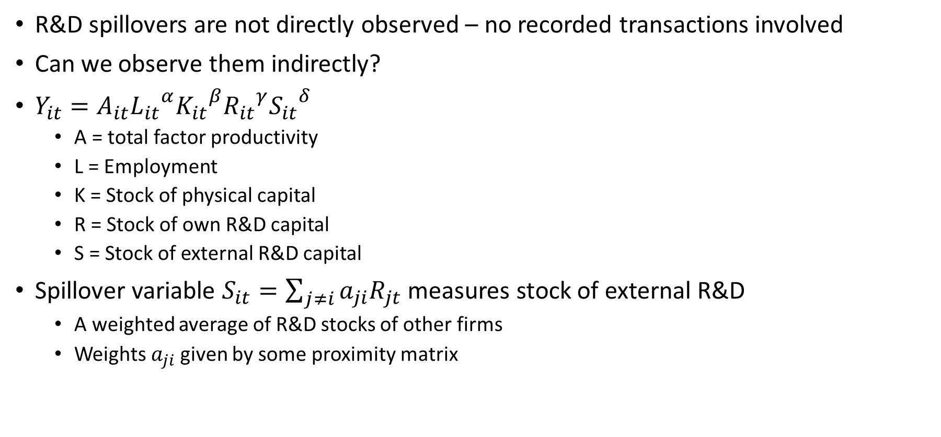
Empirical evidence on spillovers from R&D
Bloom et al. (Econometrica, 2013)
R&D spillovers are not directly observed – no recorded transactions involved
Can we observe them indirectly?
$Y_{it}=A_{it}{L_{it}}^{α}{K_{it}}^{β}{R_{it}}^{γ}{S_{it}}^{δ}$
A = total factor productivity
L = Employment
K = Stock of physical capital
R = Stock of own R&D capital
S = Stock of external R&D capital
Spillover variable $S_{it}=\sum_{j≠i}{a_{ji}R_{jt}}$ measures stock of external R&D
A weighted average of R&D stocks of other firms
Weights $a_{ji}$given by some proximity matrix

Slide 37
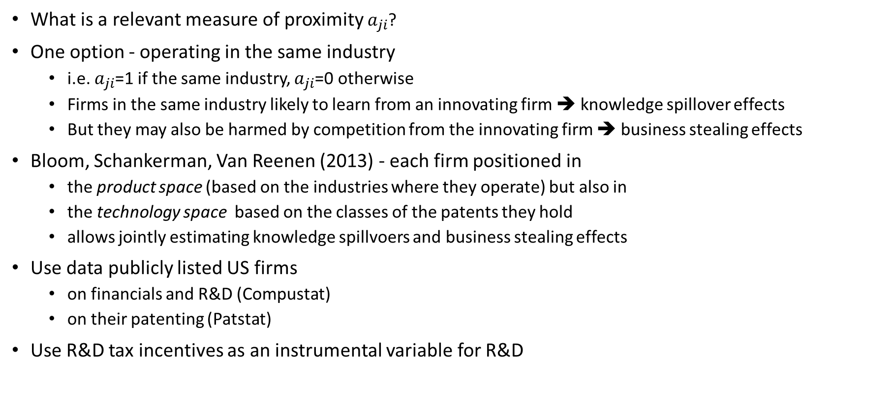
Empirical evidence on spillovers from R&D
Bloom et al. (Econometrica, 2013)
What is a relevant measure of proximity $a_{ji}$?
One option - operating in the same industry
i.e. $a_{ji}$=1 if the same industry, $a_{ji}$=0 otherwise
Firms in the same industry likely to learn from an innovating firm ➔ knowledge spillover effects
But they may also be harmed by competition from the innovating firm ➔ business stealing effects
Bloom, Schankerman, Van Reenen (2013) - each firm positioned in
the product space (based on the industries where they operate) but also in
the technology space based on the classes of the patents they hold
allows jointly estimating knowledge spillvoers and business stealing effects
Use data publicly listed US firms
on financials and R&D (Compustat)
on their patenting (Patstat)
Use R&D tax incentives as an instrumental variable for R&D

Slide 38
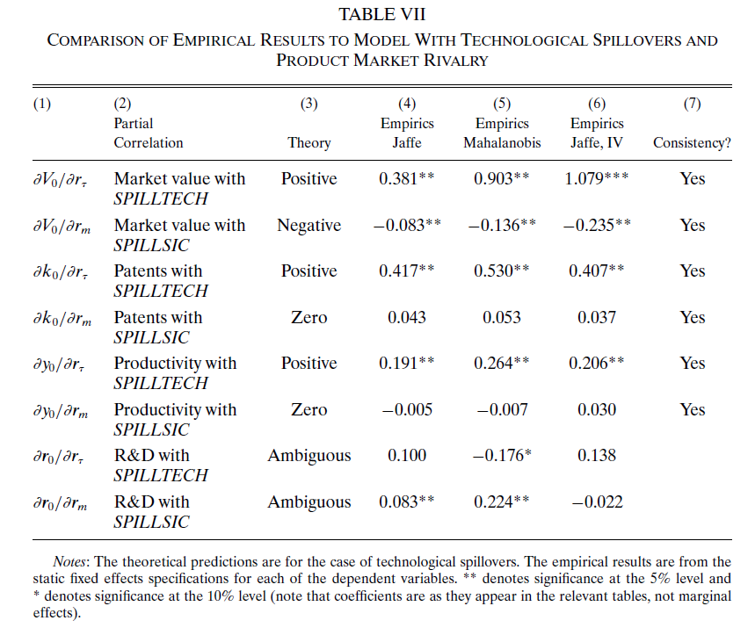
Empirical evidence on spillovers from R&D
Bloom et al. (Econometrica, 2013)

Slide 39
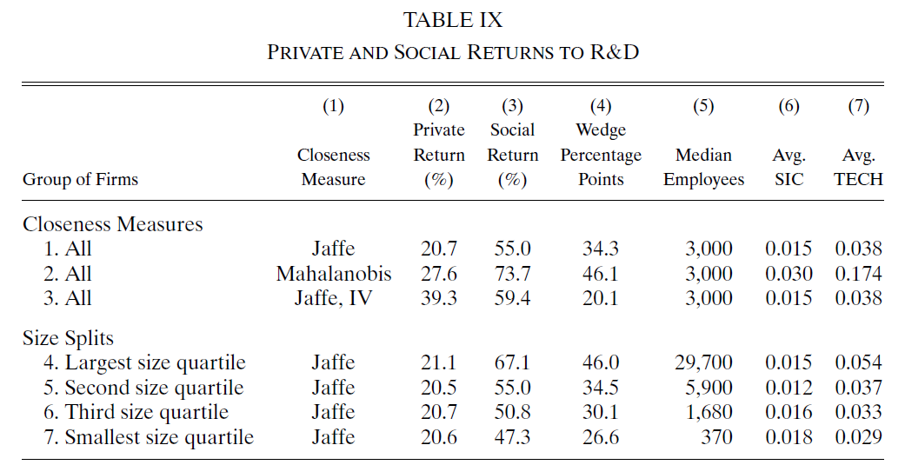
Empirical evidence on spillovers from R&D
Bloom et al. (Econometrica, 2013)

Slide 40
Topic outline
Market structure and incentives to innovate
Threat of entry and incentives to innovate
Spillovers from R&D
Public policy towards R&D
Intellectual property protection

Slide 41
R&D spillovers and public policy
Spillovers ➔ social returns > private returns ➔ Underprovision of R&D
What can policy do?
Competition policy on research joint ventures
US: Research joint ventures forbidden only if proven to be anticompetitive (normal collusion forbidden per se); Europe: Even more supportive
R&D tax incentives
Reduce effective cost of R&D to bring social and private RoR closer
R&D grants for firms
Allows steering of R&D to projects with high social return (at least in theory)
R&D done by governments (universities, public research institutes)
Especially basic research ➔ low private return, high social return
IP protection (patents, trademarks...):
Grants temporary monopoly to boost the social RoR

Slide 42
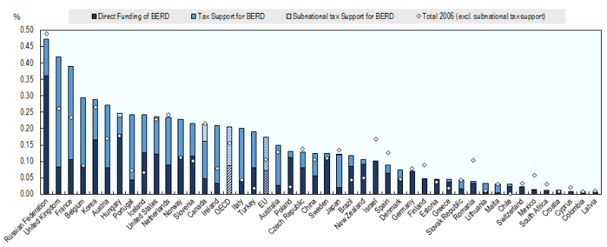
R&D spillovers and public policy
Public support for business R&D (% GDP)

Slide 43
R&D spillovers and public policy
Dechezlepretre et al. (AEJ:EP 2023)
Do R&D tax incentives actually make firms invest more in R&D?
Identifying causal effects of R&D tax incentives hard because they usually apply (at least in principle) to all firms
Dechezlepretre et al. study a reform of R&D tax incentives in the UK
SMEs: R&D costs deductible at 150% (rather than the 100% applying to other costs), refundable to loss-making firms
Large firms: R&D costs durectible at 125%, no refund to loss-making firms
A change in the SME definition meant that more firms became eligible for the SME benefits
The definition only applying to the R&D tax incentive
They apply a regression discontinuity design around the new assets threshold for SMEs of EUR 86 million

Slide 44
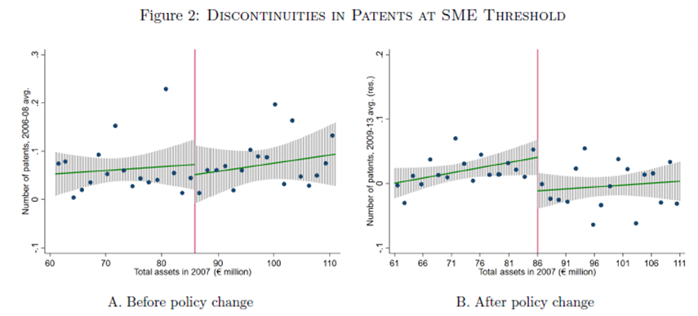
R&D spillovers and public policy
Dechezlepretre et al. (AEJ:EP 2023)
They estimate positive effects on
R&D expenditure
Own patenting (important, because R&D expenditure alone is subject to “relabeling”
Innovation of technologically close firms (spillovers)

Slide 45
R&D spillovers and public policy
Bajgar and Srholec (under review)
Similarly to R&D tax incentives, the effects of government direct subsidies for R&D (R&D grants) on private R&D expenditure is ambiguous:
Crowding-out hypothesis: Subsidies crowd out private R&D spending – if the subsidies projects had taken place even without the subsidies
Crowding-in hypothesis: Subsidies crowd in private funds – if the subsidized projects had not taken place without the subsidies and are co-financed from private sources
We estimate the effects of the first flagship scheme of the Technology Agency of the Czech Republic (TACR) - ALFA
Here the challenge is that it is not random:
Who applies for a subsidy
Whose project is selected (among those who applied)
We also apply a regression discontinuity design, this time comparing firms whose projects ended up just below and just above the threshold score for receiving support
We find

Slide 46
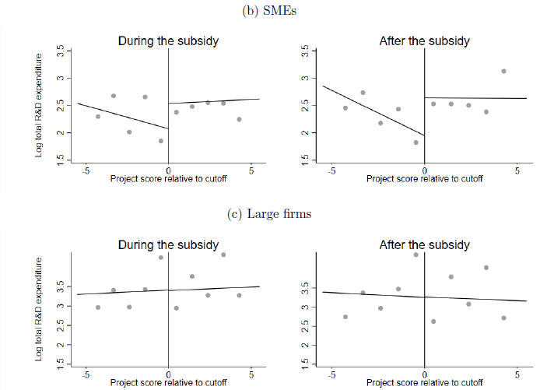
R&D spillovers and public policy
Bajgar and Srholec (under review)
For SMEs, we estimate positive effects on
Total R&D expenditure
Private R&D expenditure (evidence of crowding in)
Patenting, employment, sales (for a subgroup of firms)
We find no effects for large firms

Slide 47
Topic outline
Market structure and incentives to innovate
Threat of entry and incentives to innovate
Spillovers from R&D
Public policy towards R&D
Intellectual property protection

Slide 48
Types of IP
Patent = ?
Trademark = ?
Trade secret = ?
Copyright = ?

Slide 49
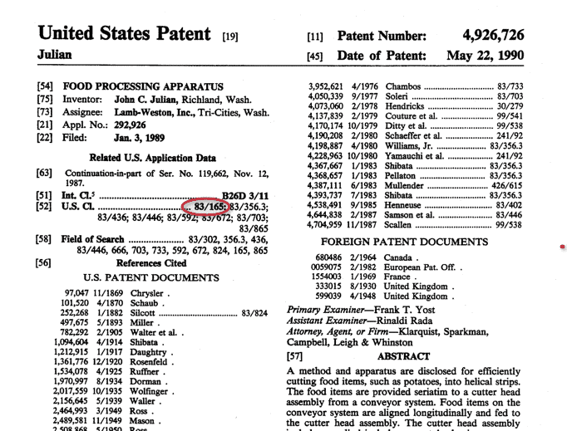



Types of IP
Patent protects an invention (require public disclosure of the invention)
Trademark protects words/images (brand names, logos...)
Trade secret give protection against dislosure through improper means (e.g. Coca-Cola recipe, Google‘s search algorithm, criteria for NYT bestseller list...)
Copyright gives protection for original works (literature, music, visual art, software...)

Slide 50
Intellectual property protection
How long should the protection last?
The key trade-off
Boost dynamic competition (incentives to innovate)
Reduce static competition (dead-weight loss from monopoly)
Social planner trades off incentives to innovate against the dead-weight loss
Incentives increase with patent duration
0 < Optimum duration < ∞
Standard duration in US and Europe
Patents: 20 years
Trademarks: indefinite (must be renewed every 10 years)
Trade secrets: indefinite
Copyrights: life of author + 70 years
?
?
?
?

Slide 51
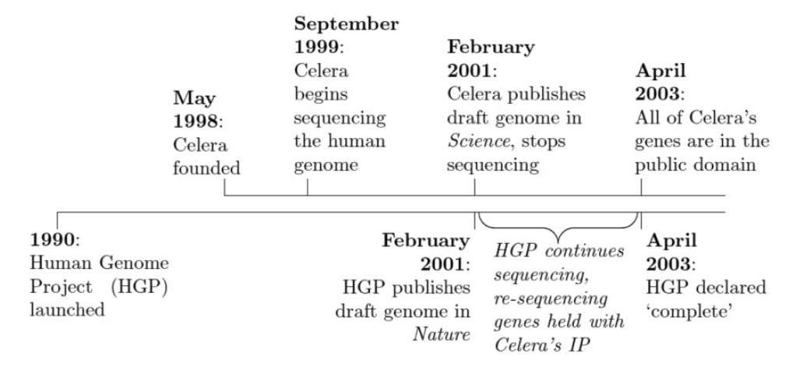
How do patents affect follow-on innovation?
Williams (JPE 2013)
Patenting awards protection but also requires a disclosure of technology
The aim of the disclosure is to allow follow-on innovation. But does it do so?
Hard to find a counterfactual – a valuable IP that could be protected but is not
The paper uses the temporary IP of a firm Celera over human genome

Slide 52
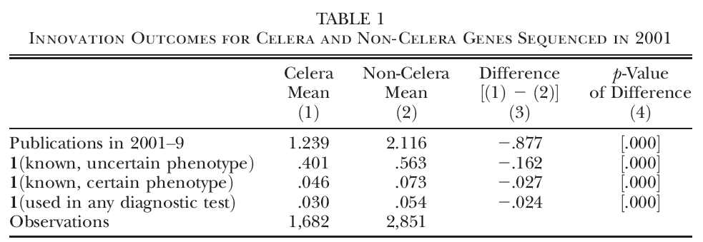
How do patents affect follow-on innovation?
Williams (JPE 2013)
Example:
Celera holds IP on a human gene
Pfizer discovers a genetic diagnostic test based on Celera‘s gene
In an ideal world, Celera and Pfizer would negotiate a licensing agreement, but in practice might not happen
Does Celera‘s IP discourage Pfizer from developing the drug?
The paper finds that Celera‘s IP protection led to a substantial reduction in subsequent research
In a separate paper, Sampat and Williams (AER 2019) do not find a similar negative effect in the case of patents
➔ indicates a key role of the disclosure in the case of patents vs. more limited disclosure in the case of Celera

Slide 53
Unintended spillovers vs. technology markets
Arqué-Castells and Spulber (JPE, 2022)
Bloom et al. (2013) and many other studies assume all observed spillovers are (positive) externalities
But firms can monetize their R&D in technology markets (e.g. through licensing), so some of the observed spillovers are simply results of market transcations
E.g.: IBM received $1.2 billion in royalty payments in 2017 alone
Arqué-Castells and Spulber (2022)
Extend the Bloom et al framework to separately measure
involuntary spillovers
voluntary knowledge transfers
Construct a new database of voluntary knowledge transfers based on disclosures mandated by the US Securities and Exchange Commission (SEC) and voluntary disclosures to the US Patent and Trademark Office (USPTO) including
Patent transfers – Firm A sells a patent to firm B
Licensing – Firm A allows firm B to use the patented technology (for a fee)
Cross licensing – Firms A and B allow each other to use their respective patented technologies
R&D alliances – Firms A and B collaborate on R&D and both are allowed to use the resulting technology

Slide 54
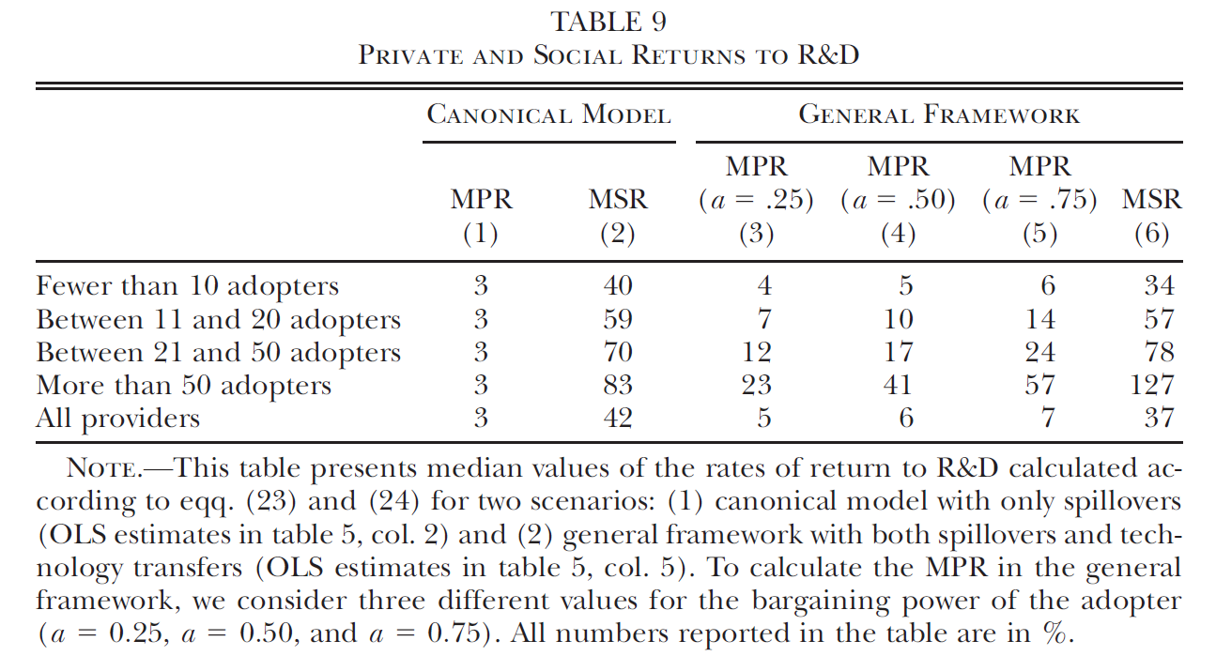
Unintended spillovers vs. technology markets
Arqué-Castells and Spulber (JPE, 2022)
Accounting for the voluntary transfers somewhat reduces the wedge between the private and social returns to R&D (but there are still large involuntary spillovers!)

Slide 55
Intellectual property protection
IPP in practice
Surveys of innovators suggest the following strategies more important than patents:
Secrecy (mainly for process innovation)
From welfare perspective: solves the underprovision due to spillovers, but leads to underutilisation
First-mover advantage (mainly for product innovation)
Why are patents not effective?
Requires disclosure
They can be „invented around“ by imitators
Costly to enforce
Pharmaceuticals and chemicals an exception – patents important

Slide 56
Intellectual property protection
IPP in practice
BUT a dramatic increase in patent applications! Why?
Relatively inexpensive to register
A way to demonstrate R&D production
Demanded by venture capitalists and public agencies
Can be used as a trading device in the presence of patent thickets
Patent thicket = a dense web of overlapping intellectual property rights that a company must hack its way through in order to actually commercialize new technology
➔ If you sue me, I sue you

Slide 57
Exercise 2: Strategic patenting (B&P 18.3)
P(q) = a – q
An incumbent has a proprietary technology with c₁ < a
An entrant could enter as a Cournot duopolist, but its technology is not competitive: c_{e} > (a+c₁)/2
Check that there is no entry in the Cournot-Nash equilibrium.
Now an alternative technology becomes available, giving c_{a}, c₁ < c_{a} < (a+c₁)/2. Show that the incumbent has a higher incentive to acquire the technology than the entrant, even though the incumbent will not use the technology.

Slide 58

What is the replacement effect?
What is the efficiency effect?
How do spillovers affect the amount of innovation?
What do governments do to support innovation?
What the is the key trade-off of more/less strict IP protection?
What questions do you have?

